Slide 1

Caller-Sensitive Specification Generation
For Cross-Language Static Taint Analysis
Presenter : Shuangxiang Kan
Supervisor: Yulei Sui​​
Notes:
Hello, everyone, my name is Shuangxiang Kan.​
I am a PhD student supervised by professor Yulei Sui. ​
The topic of my Progress review is about Cross-Language Static Program Analysis.​

Slide 2

Checklist
(06/02/2022 --- 28/05/2023)
(29/05/2023 --- today)
✅
Research Foundation
✅
Research Integrity Module
✅
Technology Research Methods
✅
Research Data Management Plan (RDMP)​
✅
1
✅
Candidature assessment 1
Submission of Paper
1: Title: Caller-Sensitive Specification Generation for Cross-Language Static Analysis
Authors: Shuangxiang Kan, Yuhao Gao, Zexin Zhong, Yulei Sui
Journal: IEEE Transactions on Software Engineering (TSE)
Notes:
Because I transferred from UTS to UNSW, and during my one-year study at UTS, I completed the Research Foundation and Technology Research Methods courses, and also passed the first stage of candidate assessment.
After transferring to UNSW, I completed the Research Integrity Module and Research Data Management Plan (RDMP) Module. And I finished my first paper:'Caller-Sensitive Specification Generation for Cross-Language Static Analysis' and submitted it to TSE

Slide 3


Contents
1
﻿Literature Review
2
﻿Our Work
3
﻿Future Work
Notes:
Today’s presentation is composed of three parts.​
The first one is the literature review.​
The second part is the work I have done about the cross-language static analysis .
The last one part is future work.
Now let’s move to the literature review part.

Slide 4
Literature Review

Slide 5
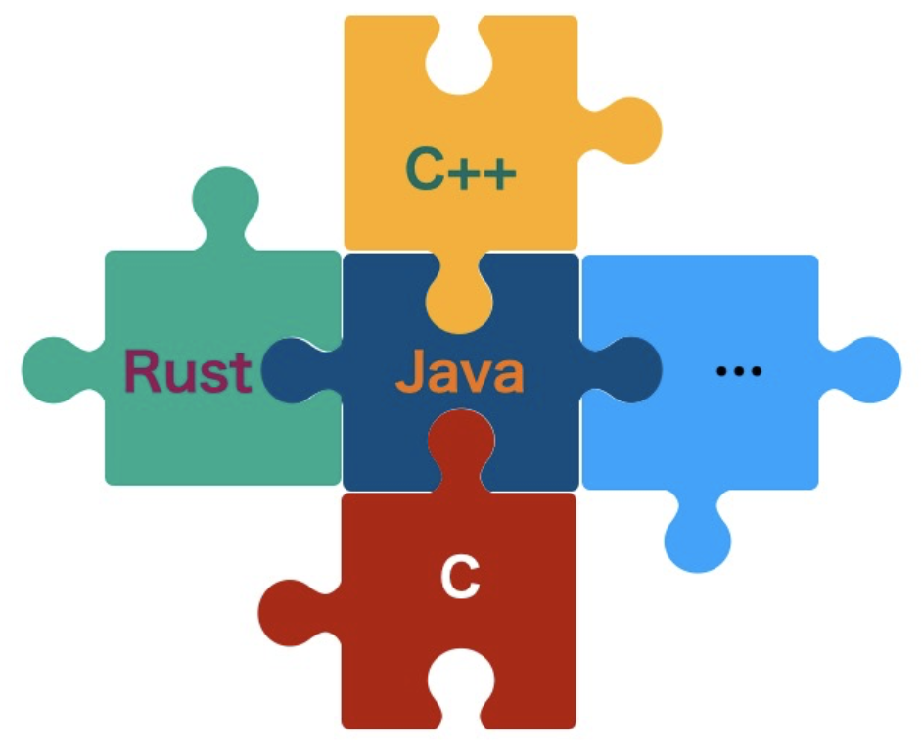
Literature review
﻿Cross-language programming is the practice of using multiple
programming languages within a single software application
or system.
Benefits:
Leverage strengths of different languages;
Code Reusability;
Platform Flexibility.
Notes:
Because my previous work is about cross-language static analysis, so first I will give some background about cross-language programming.
Cross-language programming is a common practice of using multiple programming languages within a single software application or system. It is essential for various reasons:
The first reason is that it can leverage strengths of different languages: For example, in Android development, developers use Java for user interface development and use C++ to develop platform-specific functionality.
The second reason is Code Reusability: Cross-language programming allows users to reuse of existing functions and libraries, which can save a lot of time and efforts.
The third reason is Platform Flexibility: Cross-language programming helps ensure that applications run smoothly on multiple platforms. For instance, an application can be written in Swift for iOS and Java for Android.

Slide 6


Literature review
Challenges:
Java
Complexity;
Maintenance challenges;
Security concerns (motivation).
C/C++
data leakage
Notes:
However, there are also many challenges in using cross-language programming
The first one is complexity： As different programming languages have different grammers, which may requires developers to have a deep understanding of each language.
The second challenge is maintenance challenges: Because the complexity in cross-language programming, which may introduce new bugs when updating multiple language softwares.
The third challenge is security concerns: Using multiple languages can raise the risk of security vulnerabilities. For example, In Android NDK development, malicious developers can hide their data leak code within C/C++ components. This is the motivation for our work. We aim to conduct static analysis on cross-language code to find potential risks.

Slide 7
Literature review
Conference | Title | Authors
ICSE’22 | ﻿JuCify: A Step Towards Android Code Unification for Enhanced Static Analysis Java/C/C++ limitation: accuracy | ﻿Jordan Samhi et al.
SAS’21 | ﻿A Multilanguage Static Analysis of Python Programs with Native C Extensions Python/C | ﻿Raphael Monat et al.
ASE’20 | Broadening horizons of multilingual static analysis: Semantic summary extraction from C code for JNI program analysis Java/ C/C++ limitation: accuracy | ﻿Sungho Lee et al.
CSS’18 | ﻿JN-SAF: Precise and Efficient NDK/JNI-aware Inter-language Static Analysis Framework for Security Vetting of Android Applications with Native Code Java/C/C++ limitation: scalability | ﻿Fengguo Wei et al.
ASE’16 | ﻿HybriDroid: Static Analysis Framework for Android Hybrid Applications ﻿Java/JavaScript | Sungho Lee et al.
ECOOP’14 | ﻿Finding Reference-Counting Errors in Python/C Programs with Affine Analysis Python/C | ﻿Siliang Li et al.
Notes:
Here’s the papers related to cross-language static analysis.
Because our work is about Java and C/C++, ICSE‘22, ASE’20, and CSS‘18 are closely related to our research. However, these papers have some limitations, for instance, Jucify has accuracy issue, while JN-SAF is limited to its scalability.

Slide 8
Literature review
﻿IR (intermediate representation)
ICSE’22
Advantage
Eliminate the differences
Limitations
Different data types
Information loss
Unable to be reused by other static analyzers
C/C++
Rust
LLVM IR
？
C/C++
Java/Python/JavaScript
Notes:
Based on the papers mentioned above, a commonly used approach is to compile different programming languages into a common Intermediate Representation (IR).
This helps eliminate the differences between different languages. For example, languages like C/C++ and Rust can be compiled into LLVM IR.
However, the limitatins of this approach is that not all programming languages can be compiled into a unified IR. For instance, languages like C/C++, Java, Python, and JavaScript, based on my knowledge, there is no well-designed IR that can represent them without loss of information.
In addition, some IR can only be utilized by specific static analyzers and lack generality.

Slide 9
Literature review
Specifications are simplified descriptions or abstractions of a function or component.
Java
C/C++
ASE’20
Advantages
Avoid extensive modifications to existing static analyzers.
Easy adaptation to changes or different requirements
Limitation
Difficulty in generating high-precision specifications.
experts
Static analyzer
Specifications
Summarize the side-effects
of C/C++ code
Result
Our work: Caller-Sensitive Specification Generation For Cross-Language Static Taint Analysis
Notes:
The second commonly used approach is specifications. Specifications are simplified descriptions or abstractions of a function or component.
For example, in the right figure, we can summarize the side effects of C/C++ functions and provide them to the Java static analyzer in the form of specifications.
The first advantage of using specifications is it extensive modifications to existing static analyzers, ﻿Many static analysers i﻿nclude interfaces to manage specifications.
The second advantage is Specifications can be easily adapted to changes in different programming code or different requirements.
However, the limitation of using specifications is it is difficult to generate high-precision specifications. Currently, most specifications are currently manually crafted, which cost a lot of and efforts.
We think using specifications for cross-language static analysis is a relatively simple and effective approach
Therefore, we proposes a new approach for automatically generating accurate taint flow specifications in cross-language analysis.

Slide 10
Our work
Title: Caller-Sensitive Specification Generation for Cross-Language Static Analysis
Authors: Shuangxiang Kan, Yuhao Gao, Zexin Zhong, Yulei Sui
Journal: IEEE Transactions on Software Engineering (TSE)

Slide 11
Our work
JNI background
Java code:
Java Native Interface(JNI), is a programming framework
that allows Java code to interact with native applications
and libraries written in other languages, such as C/C++.
public class JavaCaller {
private native void native_c_callee(User u1, User u2);
}
Class User{
public string username.
}
JNI call
Java method: Java method with “native” keyword
C/C++ function: Java_PackageName_ClassName_MethodName
JNI functions: JNI provides a set of functions to callback Java
methods and fields (e.g., GetObjectClass())
C++ code:
JNIEXPORT void JNICALL Java_JavaCaller_native_c_callee
(JNIEnv *env, jobject instance, jobject a, jobject b)
{
jclass cls = env->GetObjectClass(b);
fieldID fId = env->GetFieldID(cls, “username”, "Ljava/lang/String;");
jstring name = env->GetObjectField(b,fId);
…
}
Notes:
The focus of our work is JNI (Java Native Interface). JNI is a programming framework that allows Java code to interact with native applications and libraries written in other languages, such as C/C++.
In Java, methods‘ declaration with “native” keyword are used to call C/C++ functions, and the corresponding naming convention for C++ functions typically involves using underscores to connect the Java, PackageName, ClassName, and MethodName.
In addition, JNI also provides a set of functions that allow C/C++ functions to callback Java methods and.

Slide 12
Our work
Overview
We propose Caller-Sensitive Specification (CSS) , a new specification, to enhance static value-flow analysis of Java programs that use JNI to interact with C/C++ code.
Advantages
Consider the caller information of invoked C/C++ functions.
Specifications are accurate and small.
Enhance the ability of Java monolingual static analyzers for cross-language taint flow tracking
Notes:
We propose a new type of specification called Caller-sensitive specification, to enhance static data-flow analysis of Java programs that use JNI to interact with C/C++ code.
The Caller-sensitive specification has the following advantages, the first is CSS considers the calling context of the invoked C/C++ functions,
Because the arguments information passed from the caller to the callee directly influences the behaviours of the callee, having caller information can help avoid many unnecessary scenarios, leading to accurate and concise specification generation.
The experiments show that CSS can enhance the capabilities of Java monolingual static analyzers for cross-language analysis.

Slide 13

Our work
Example
JNI_class.java
native_func.cpp
$$\underset{→}{compile to}$$
libnative_func.so
J1.
J2.
J3.
J4.
J5.
J6.
J7.
J8.
J9.
J10.
J11.
J12.
J13.
J14.
public class JavaCaller {
private native void native_c_callee(User u1, User u2);
private void caller (Request request ) { // Caller
User user = new User();
user.setUserName(request.getUsername()); // Source
user.setPassword(request.getPassword());
User loginUser = user;
native_c_callee(user, loginUser); // Native call
}
}
public class User{
private string username, password;
…
}
C1.
C2.
C3.
C4.
C5.
C6.
C7.
C8.
C9.
C10.
C11.
C12.
// JNI callee function
JNIEXPORT void JNICALL Java_JavaCaller_native_c_callee
(JNIEnv *env, jobject instance, jobject a, jobject b)
{
Model* model = new Model();
// char *name = b.getUsername();
jclass cls = env->GetObjectClass(b);
jfieldID fId = env->GetFieldID(cls, “username”, "Ljava/lang/String;");
jstring name = env->GetObjectField(b,fId);
model−>setUserInfo(name);
Log. print (model−>getUserInfo()); // Sink
}
b.username
flow to
a.username, b.username
Log.print()
Notes:
Here is a simple example to explain why CSS requires caller information.
﻿The source data is store into the field username of object user, and at Lin7, user and loginUser are aliased. Then at line j8, native method natve_c_callee() are called to invoke C++ function Java_JavaCaller_native_c_callee. The purpose of Lines C7, C8 and C9 is to get the username of o2, and o2’s username will finally flow to Log.print().
If we know the caller information of callsite native_c_callee(), that user and loginUser are alised, since o2.username flows to the log,print(), then o1.username flows to Log.print() too. We can get the right source-sink path.

Slide 14

Our work
Example
1. Optimistic handling of JNIs
native_func.cpp
$$\underset{→}{compile to}$$
libnative_func.so
C1.
C2.
C3.
C4.
C5.
C6.
C7.
C8.
C9.
C10.
C11.
C12.
// JNI callee function
JNIEXPORT void JNICALL Java_JavaCaller_native_c_callee
(JNIEnv *env, jobject instance, jobject a, jobject b)
{
Model* model = new Model();
// char *name = b.getUsername();
jclass cls = env->GetObjectClass(b);
jfieldID fId = env->GetFieldID(cls, “username”, "Ljava/lang/String;");
jstring name = env->GetObjectField(b,fId);
model−>setUserInfo(name);
Log. print (model−>getUserInfo()); // Sink
}
?
(b) C++ code
Notes:
However, if we don’t know the caller information and directly analyze native_c_callee() function, the first challenge is JNI functions. If we want to get the username of b, we need to know the object type of b. JNI uses jobject to represent all java object in C++ code, and there is no specific information about b. but at Line 7, since we have no idea about what b is, the analysis is broken at Line 7, resulting in no data leak. This optimistic approach assumes no side effects on unresolved JNI functions, simplifying analysis but getting the unsound results.

Slide 15
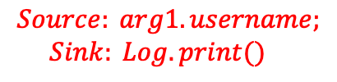

Our work
Example
2. Pessimistic handling of JNIs
native_func.cpp
$$\underset{→}{compile to}$$
libnative_func.so
Conservative specification:
C1.
C2.
C3.
C4.
C5.
C6.
C7.
C8.
C9.
C10.
C11.
C12.
// JNI callee function
JNIEXPORT void JNICALL Java_JavaCaller_native_c_callee
(JNIEnv *env, jobject instance, jobject a, jobject b)
{
Model* model = new Model();
// char *name = b.getUsername();
jclass cls = env->GetObjectClass(b);
jfieldID fId = env->GetFieldID(cls, “username”, "Ljava/lang/String;");
jstring name = env->GetObjectField(b,fId);
model−>setUserInfo(name);
Log. print (model−>getUserInfo()); // Sink
}
If (alias(arg0, arg1) == true)
?
$$Source: arg0.username, arg1.username;$$
$Sink: Log.print()$
If (alias(arg0, arg1) == false)
$$Source: arg1.username;$$
$Sink: Log.print()$
Redundant!
(b) C++ code
Notes:
Even we know the object type represented by ‘b,' the second challenge in isolating the analysis of 'native_c_callee' is the lack of knowledge about the relationships between the parameters. To ensure the accuracy of the analysis, given that ‘a' and ‘b' have the same type, we need to consider the alias relationship between ‘a' and ‘b.' This results in a conservative specification. However, in a real Java calling context, we already know that ‘a' and ‘b' are aliases. Therefore, the second case in the specification, where ‘a' and ‘b' are not aliases, becomes redundant.

Slide 16






Our work
Workflow
iterative
①
Native method detection
②
Taint and alias arguments check
Input
③
⑨
⑧
Caller specification
Caller-sensitive callee specification
Analysis result
Native function identification
⑤
Taint and alias arguments annotation
⑥
Source and sink identification
⑦
LLVM IR
④
SVFG
Notes:
﻿The above figure shows the workflow of value-flow analysis with caller sensitive specifications. First, we use Java static analyzer like, Flowdroid or Taie-e, to identify native method with tainted arguments, it also checked if alias relationships between arguments. Then a caller specification is generated to record the caller information and send to C/C++ analyzer to continue the analysis, after getting the caller specification, it will be with LLVM IR code compiled by c/c++ code to conduct taint analysis, this stage involves native function identification, taint and alias arguments annotation, native sources and sinks identifications and SVFG generation, Finally, caller-sensitive callee specification with native source-sink paths is generated and sent to Java static analysis to continue the analysis. This process is conducted in an iterative way until a fixed point is reached.

Slide 17
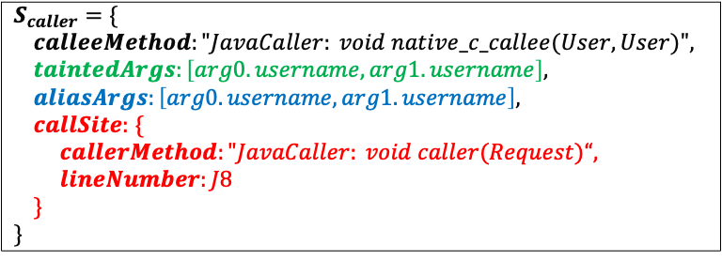
Our work
Caller Specification
JNI_class.java
Caller’s Specification
J1.
J2.
J3.
J4.
J5.
J6.
J7.
J8.
J9.
J10.
public class JavaCaller {
private native void native_c_callee (User u1, User u2);
private void caller(Request request ){
User user = new User();
user.setUserName(request.getUsername());
user.setPassword(request.getPassword()) ;
User loginUser = user;
native_c_callee(user, loginUser);
}
}
$S_{caller}=$ $\{$
$calleeMethod:"JavaCaller: void native_c_callee(User, User)",$
$taintedArgs:\left[arg0.username, arg1.username\right],$
$aliasArgs:\left[arg0.username,arg1.username\right],$
$callSite:$ $\{$
$callerMethod:"JavaCaller: void caller(Request)“,$
$lineNumber:J8$
$\}$
$\}$
calleeMethod: signature of called native method;
tainedArgs: tainted arguments;
aliasArgs: aliased arguments;
callSite: the caller method and the location of native call
Notes:
More specifically, once we find a native method with tainted data, we use a 4-tuple to record caller information, that is (Se, D, A, C)
𝑆_𝑒 (calleeMethod): the signature of the called native method.
𝐷 (taintedArgs): tainted arguments.
𝐴 (aliasArgs): aliased arguments.
𝐶 (callSite): the caller method and the location of the native call.

Slide 18
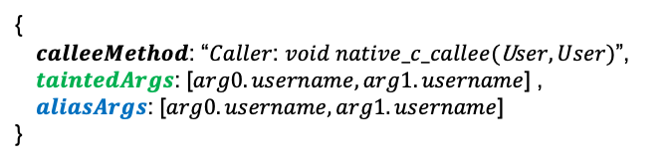
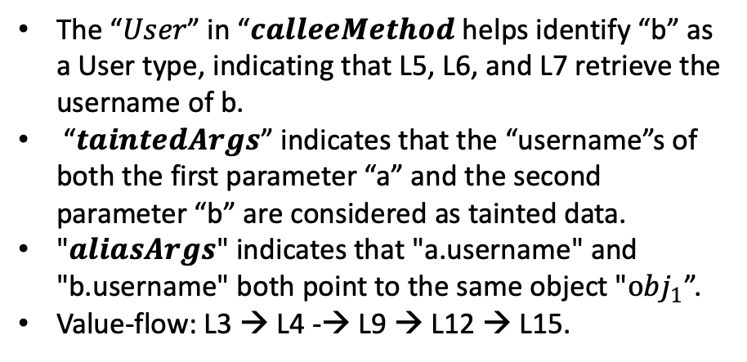
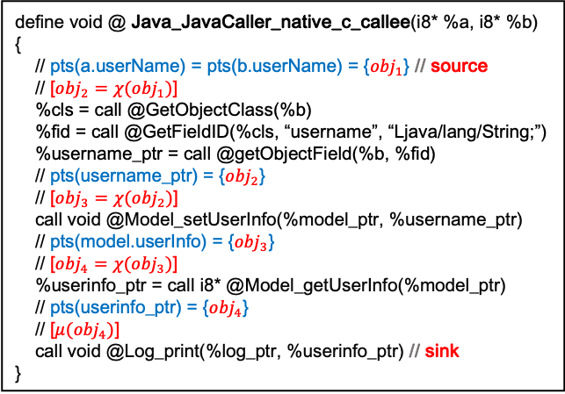
Our work
Value-flow analysis
{ 𝒄𝒂𝒍𝒍𝒆𝒆𝑴𝒆𝒕𝒉𝒐𝒅: “𝐶𝑎𝑙𝑙𝑒𝑟: $void native_c_callee($U$ser, User)$”, 𝒕𝒂𝒊𝒏𝒕𝒆𝒅𝑨𝒓𝒈𝒔: [$arg0.username, arg1.username$] , 𝒂𝒍𝒊𝒂𝒔𝑨𝒓𝒈𝒔: [$arg0.username, arg1.username$] }
The “𝑈𝑠𝑒𝑟” in “𝒄𝒂𝒍𝒍𝒆𝒆𝑴𝒆𝒕𝒉𝒐𝒅 helps identify “b” as a User type, indicating that L5, L6, and L7 retrieve the username of b.
“𝒕𝒂𝒊𝒏𝒕𝒆𝒅𝑨𝒓𝒈𝒔” indicates that the “username”s of both the first parameter “a” and the second parameter “b” are considered as tainted data.
"𝒂𝒍𝒊𝒂𝒔𝑨𝒓𝒈𝒔" indicates that "a.username" and "b.username" both point to the same object "${obj}_{1}$”.
Value-flow: L3 → L4 -→ L9 → L12 → L15.
LLVM IR
L1.
L2.
L3.
L4.
L5.
L6.
L7.
L8.
L9.
L10.
L11.
L12.
L13.
L14.
L15.
L16.
L17.
define void @ Java_JavaCaller_native_c_callee(i8* %a, i8* %b)
{
// pts(a.userName) = pts(b.userName) = {${obj}_{1}$} // source
// [${obj}_{2}=χ({obj}_{1})$]
%cls = call @GetObjectClass(%b)
%fid = call @GetFieldID(%cls, “username”, “Ljava/lang/String;”)
%username_ptr = call @getObjectField(%b, %fid)
// pts(username_ptr) = {${obj}_{2}$}
// [${obj}_{3}=χ({obj}_{2})$]
call void @Model_setUserInfo(%model_ptr, %username_ptr)
// pts(model.userInfo) = {${obj}_{3}$}
// [${obj}_{4}=χ({obj}_{3})$]
%userinfo_ptr = call i8* @Model_getUserInfo(%model_ptr)
// pts(userinfo_ptr) = {${obj}_{4}$}
// [$μ({obj}_{4})$]
call void @Log_print(%log_ptr, %userinfo_ptr) // sink }
value-flow
Notes:
Once the caller specification is generated, we can use it to do a value flow analysis for the C++ function.
After constructing the SVFG, we will know the value-flow between the sources and sinks.

Slide 19
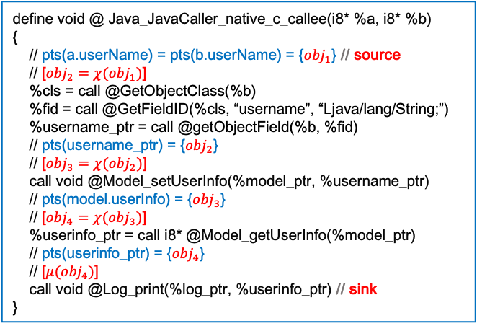
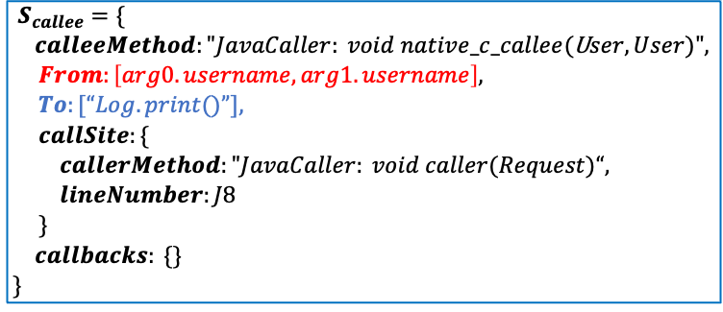
Our work
Caller-sensitive specification
LLVM IR
Caller-sensitive specification
L1.
L2.
L3.
L4.
L5.
L6.
L7.
L8.
L9.
L10.
L11.
L12.
L13.
L14.
L15.
L16.
L17.
define void @ Java_JavaCaller_native_c_callee(i8* %a, i8* %b)
{
// pts(a.userName) = pts(b.userName) = {${obj}_{1}$} // source
// [${obj}_{2}=χ({obj}_{1})$]
%cls = call @GetObjectClass(%b)
%fid = call @GetFieldID(%cls, “username”, “Ljava/lang/String;”)
%username_ptr = call @getObjectField(%b, %fid)
// pts(username_ptr) = {${obj}_{2}$}
// [${obj}_{3}=χ({obj}_{2})$]
call void @Model_setUserInfo(%model_ptr, %username_ptr)
// pts(model.userInfo) = {${obj}_{3}$}
// [${obj}_{4}=χ({obj}_{3})$]
%userinfo_ptr = call i8* @Model_getUserInfo(%model_ptr)
// pts(userinfo_ptr) = {${obj}_{4}$}
// [$μ({obj}_{4})$]
call void @Log_print(%log_ptr, %userinfo_ptr) // sink }
$S_{callee}=\{$
$calleeMethod:"JavaCaller: void native_c_callee($U$ser, User)",$
$From:\left[arg0.username, arg1.username\right],$
$To:[“Log.print()”],$
$callSite:\{$
$callerMethod:"JavaCaller: void caller(Request)“,$
$lineNumber:J8$
$\}$
$callbacks: \{\}$
$\}$
calleeMethod: signature of called native method;
From: sources in native code;
To: sinks in native code;
callSite: the caller method of location of native call
callbacks: callback Java methods and fields

Slide 20
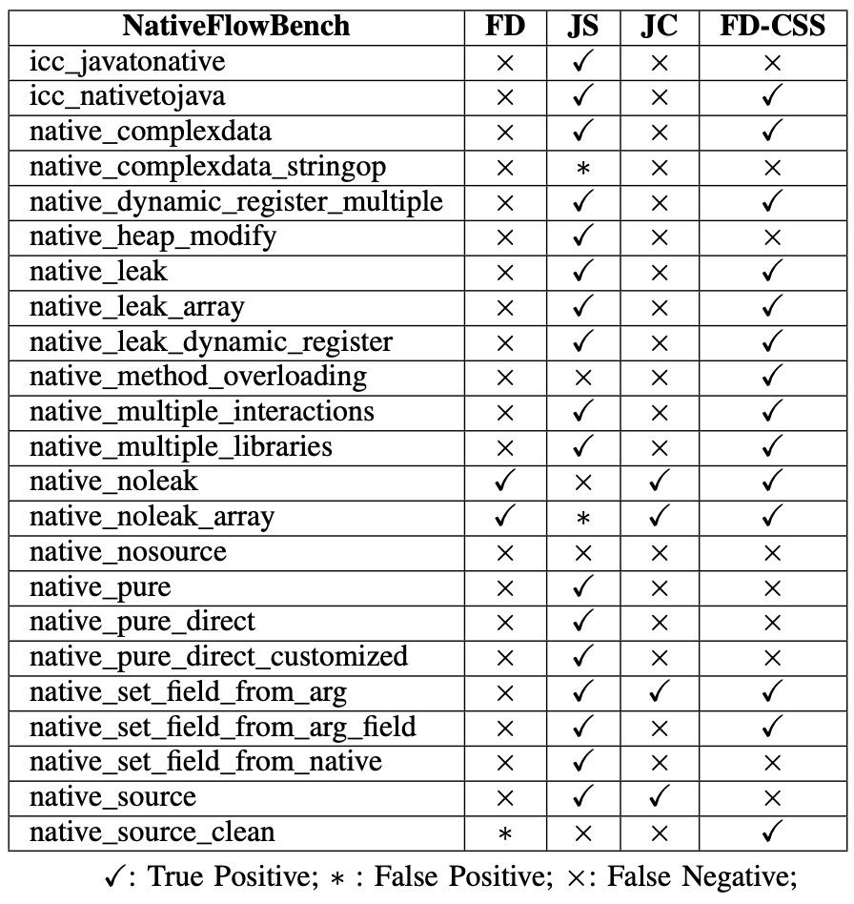
Our work
Experiment 1
 | Successful | Failed
FlowDroid (FD) | 2 | 21
JN-SAF (JS) | 17 | 6
JuCify (JC) | 4 | 19
FlowDroid-CSS (FD-CSS) | 14 | 9
Failed cases：
JNI calls are initiated from the native code
String operations
TABLE I: Results of NativeFlowBench benchmarks.
Notes:
We conducted three experiments to validate the caller-sensitive specifications we proposed. The first experiment involved using a publicly available benchmark called "nativeflowbench.”
And we use four tools to do this experiment.
FlowDroid is an Android static analysis tool, but it only focus on Java code, and it doesn’t hand native code. The results of FlowDroid is not satisfactory. Therefore, we combine Flowdroid with CSS to see if our proposed approach can enhance the ability of Flowdroid to do cross-language taint analysis. The results indicate that Flowdroid-CSS has greatly improved the cross-language analysis capabilities of Flowdroid, achieving success in 14 out of 23 cases.
However, there were still nine cases that failed. The failures can be attributed to two reasons.
First, in these seven cases, the JNI calls were not initiated from the Java side, making it impossible to generate caller specifications and consequently perform subsequent analysis. Second, the failures were related to string operations. Currently, CSS's value-flow analysis does not consider the specific content within string variables.

Slide 21
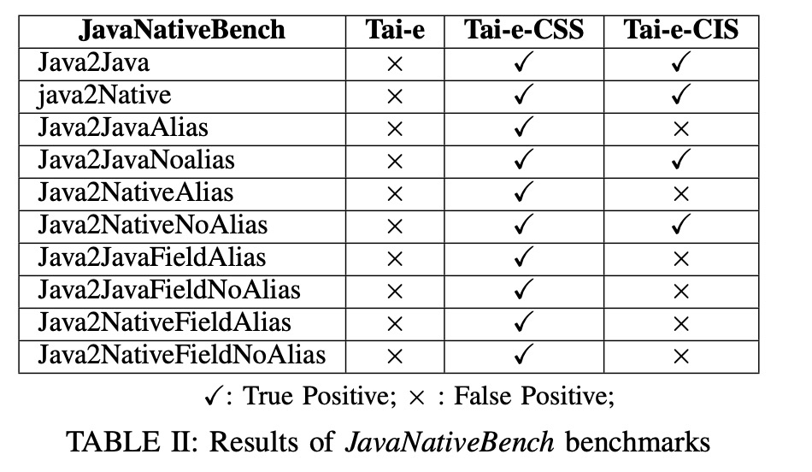
Our work
Experiment 2
Tai-e-CIS Failed cases：
Unresolved JNI functions：
Java2JavaFieldAlias, Java2JavaFieldNoAlias, Java2NativeFieldAlias, and Java2NativeFieldNoAlias
Lack of alias relationships between parameters:
Java2JavaAlias
Java2NativeAlias
CIS (Caller-insensitive specification): Isolated analysis of native
code, without considering alias relationships between parameters.
Notes:
In addition, we designed some Java cases to validate our Caller-Sensitive Specifications (CSS). Similar to Flowdroid, Tai-e is another Java static analysis tool that focuses only on Java code while ignoring native code. Tai-e's performance was not satisfactory. However, Tai-e-CSS succeeded in all cases.
Furthermore, we compared it with Caller-Insensitive Specifications (CIS), which involve the isolated analysis of native code without considering alias relationships between parameters. It can be observed that Tai-e-CIS failed in six out of these cases, mainly for the reasons we mentioned earlier. CIS is unable to handle JNI functions, and because it lacks caller information, it misses some source-sink paths.

Slide 22
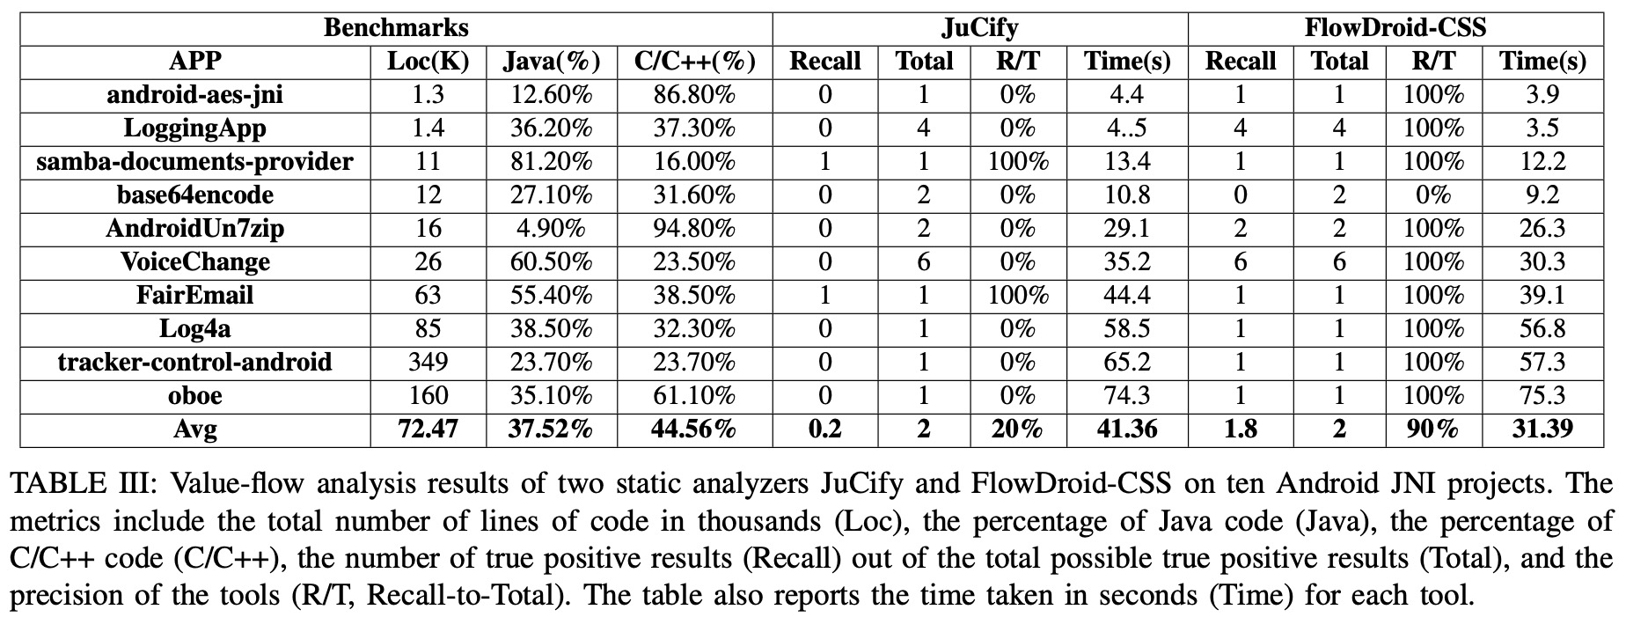
Our work
Experiment 3
Mathematical
operations
Notes:
Finally, we selected 10 projects from GitHub to validate our approach. We used both Flowdroid-CSS and Jucify to analyze these projects. From the table, it can be seen that Jucify succeeded in only two cases, mainly due to its limitations in handling native functions. On the other hand, Flowdroid-CSS had only one failed case, primarily because that case involved a significant amount of mathematical operations. Currently, SVF has significant limitations in dealing with implicit value-flow of this kind.
The results of these three experiments demonstrate that CSS can significantly enhance the capabilities of Java static analyzers for cross-language analysis.

Slide 23
Our work
Limitations
Limitations
The first limitation is the inadequate handling of implicit value-flow, especially in cases involving mathematical
or string operations.
The second limitation arises when there are changes in the information of the Java caller, resulting in a change
in the calling context. In such cases, it becomes necessary to create a new caller-sensitive specification.
The third limitation is that if JNI calls originate from native code without caller specifications, it becomes
impossible to generate subsequent caller-sensitive specifications.
Notes:
Although the CSS we proposed effectively enhances the capabilities of Java monolingual static analyzers for cross-language analysis,
The first limitation is the inadequate handling of implicit value-flow, especially in cases involving mathematical or string operations.
The second limitation arises when there are changes in the information of the Java caller, resulting in a change in the calling context. In such cases, it becomes necessary to create a new caller-sensitive specification.
The third limitation is that if JNI calls originate from native code without caller specifications, it becomes impossible to generate subsequent call-sensitive specifications.

Slide 24
Our work
Summary
Summary
Caller-sensitive specification considers the caller context across languages, leading to more precise and smaller
specifications, reducing spurious results and sizes of the specifications.
The caller-sensitive specification approach is compatible with single-language static analysis tools. By adding the
proposed specification, static analyzers can perform cross-language.
The experimental results show that caller-sensitive specifications approach can more accurately track the flow
of data.
Notes:
Here is the summary, Caller-sensitive specification considers the calling context across languages, leading to more precise and smaller Specifications, reducing spurious results and sizes of the specifications. The caller-sensitive specification approach is compatible with single-language static analysis tools. By adding the proposed specification, static analyzers can perform cross-language analysis with minor code changes. The smaller and more precise caller-sensitive specifications can reduce the complexity of parsing and speed up static analysis. The experimental results also show that caller-sensitive specifications approach can more accurately track the flow of data.
Our work on caller-sensitive specification has been submitted to TSE with the title of "Caller-sensitive Specification Generation for Cross-language Static Analysis

Slide 25
Future work

Slide 26
Future work
Currently, the specifications are based on source code, and next, we are exploring whether it's possible to generate
specifications in scenarios where there is no source code, such as having only binary code.
Literature review
(05/09/2023)
System Design
(05/11/2023)
Implementation
(05/12/2023)
Paper Writing
(05/02/2024)
Submission
(05/04/2024)
Timeline:
Notes:
First, I do a literature review, and then conduct a system design with my supervisors. Following that, we do experiments to validate our idea. Finally, I plan to spend two months on writing the paper and submit it.

Slide 27

Thank you
And Questions ?

